Slide 1
EUROPEAN DIGITAL PORTFOLIO FOR UNIVERSITY STUDENTS
European Digital Portfolio for University Students
“The e-Portfolio for all University Students in Europe”
This project is supported by the EU. Any communication or publication related to the Project made by the beneficiaries jointly or individually in any form and using any means, shall indicate that it reflects only the author's view and that the NA and the Commission are not responsible for any use that may be made of the information it contains.

Slide 2
B3. Navigation
Available features, brief explanation of what is in each page.
Five main categories:
Portfolio Home
Portfolio Folders/Categories
Portfolio information
Account Settings
Logout
This project is supported by the EU. Any communication or publication related to the Project made by the beneficiaries jointly or individually in any form and using any means, shall indicate that it reflects only the author's view and that the NA and the Commission are not responsible for any use that may be made of the information it contains.

Slide 3
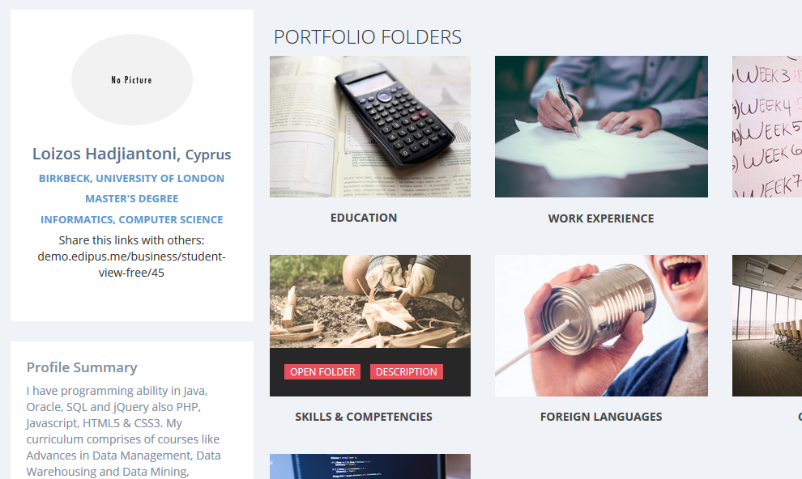
B3. Navigation
Portfolio Home contains:
Profile Picture
Introductory Video and Profile Summary
Profile Folders
This project is supported by the EU. Any communication or publication related to the Project made by the beneficiaries jointly or individually in any form and using any means, shall indicate that it reflects only the author's view and that the NA and the Commission are not responsible for any use that may be made of the information it contains.

Slide 4
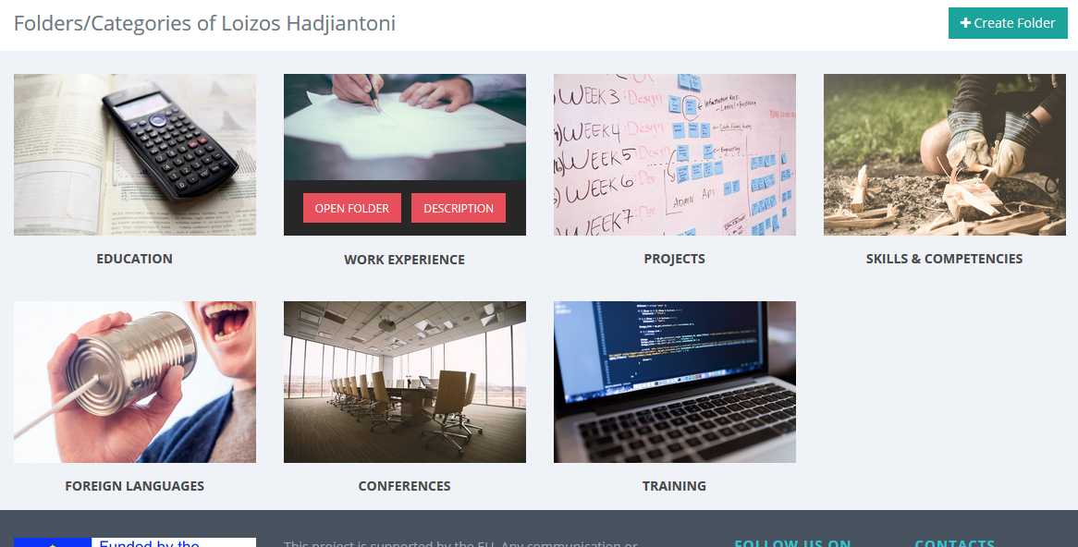
B3. Navigation
Portfolio Folders/Categories this category allow you create folder and create/edit Content.
This project is supported by the EU. Any communication or publication related to the Project made by the beneficiaries jointly or individually in any form and using any means, shall indicate that it reflects only the author's view and that the NA and the Commission are not responsible for any use that may be made of the information it contains.

Slide 5
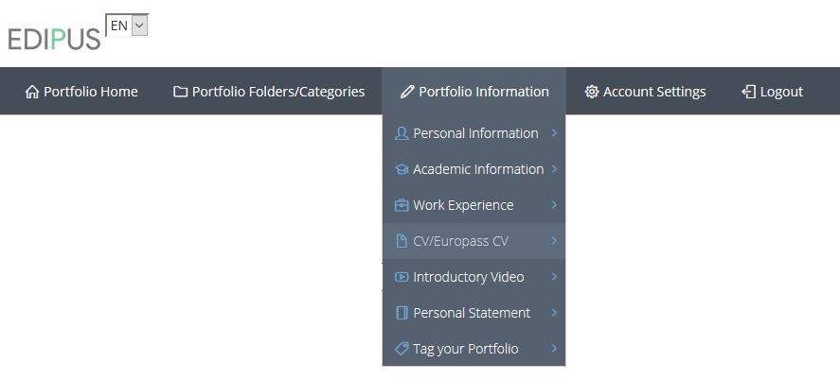
B3. Navigation
Portfolio Information contains:
Personal Information
Academic Information
Work Experience
CV/Europass CV
Introduction Video
Personal Statement
Tag your Portfolio
This project is supported by the EU. Any communication or publication related to the Project made by the beneficiaries jointly or individually in any form and using any means, shall indicate that it reflects only the author's view and that the NA and the Commission are not responsible for any use that may be made of the information it contains.

Slide 6
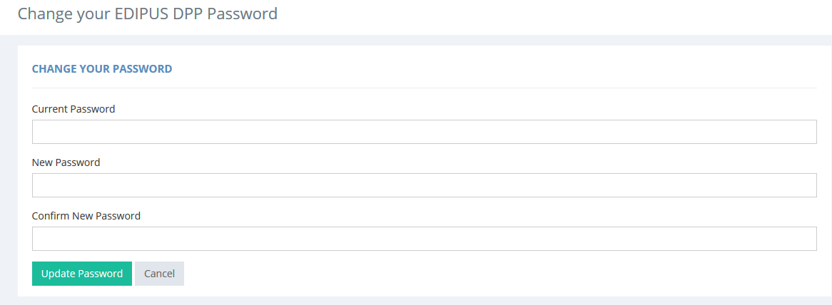
B3. Navigation
Account Settings allow you change your EDIPUS DPP Password
This project is supported by the EU. Any communication or publication related to the Project made by the beneficiaries jointly or individually in any form and using any means, shall indicate that it reflects only the author's view and that the NA and the Commission are not responsible for any use that may be made of the information it contains.

